Slide 1

Binary Bards: Unleashed
CS 271 – Object Orientated Programming
(Project Lead) - Shabhan George
(QA Tester) - Michael Gremse
(Lead Developer) - Zachary A. Carmichael
(Documentation) - Jason Edgington
A Turn-Based Dungeon Crawler

Slide 2
Development Overview
2
Project Proposal & Planning
Design and Research
The Skeleton Program
Switching to Unity
Testing & Debugging
The Demo

Slide 3
Core Concepts
4 Bard Characters
Continuous Gameplay
Turn-Based Combat
Random Room Descriptions
The “Tower”

Slide 4
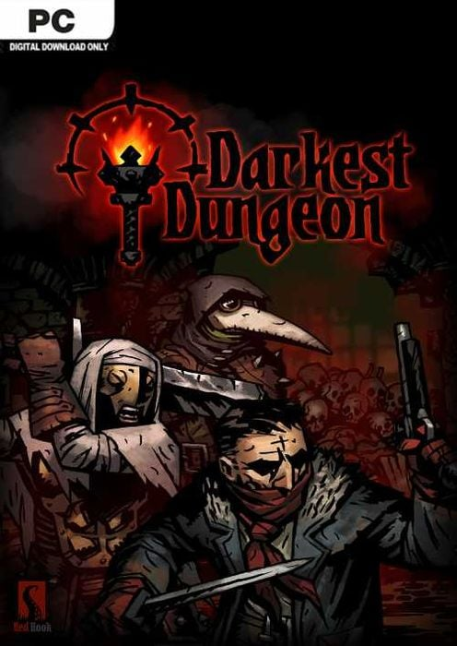


Inspiration & Research
4
Darkest Dungeons
Pokémon Emerald
Persona 3: Reloaded
Pokémon Mystery Dungeon
Classic Final Fantasy

Slide 5
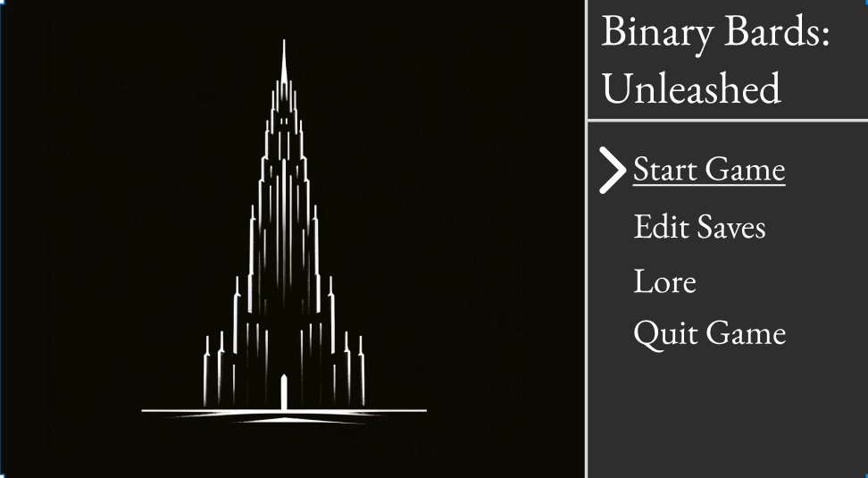
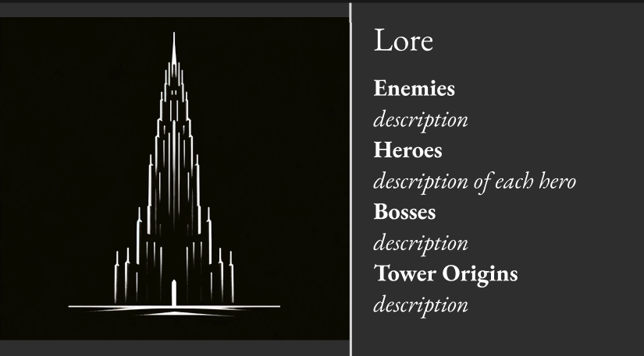
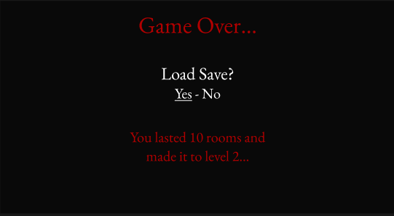
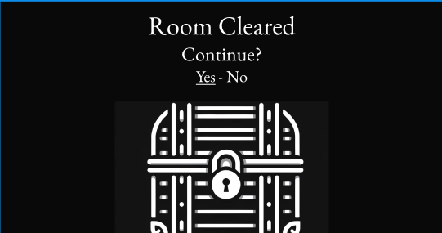
UI Concepts

Slide 6
Functional Requirements
6
Frontend:
Intuitive GUI
Sprite-Based Animations
Gameplay:
Character Progression
Inventory
Leveling
Procgen Dungeon Crawling
Backend:
Saving (Inventory, Levels, HP)
Loading
Turn-Based Combat Loop
Level Generation
Enemy Spawning

Slide 7
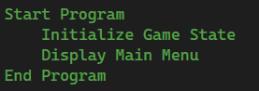
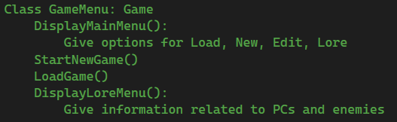
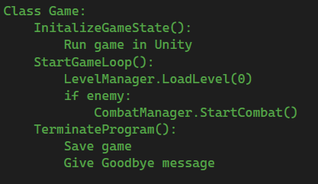
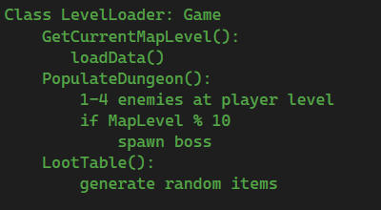
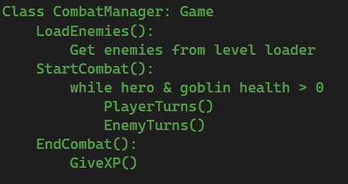
The Skeleton Program
The Main Game Logic
Main Menu Logic
Level Loader

Slide 8
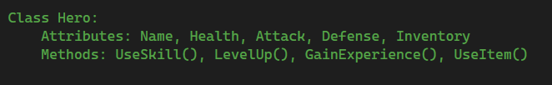
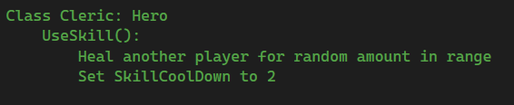
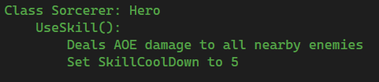
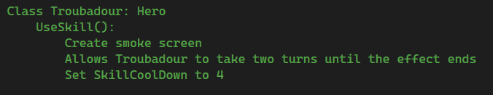
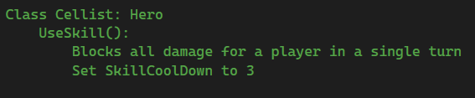
Hero Classes
Hero Class
Cleric Child
Sorcerer Child
Troubadour Child
Cellist Child

Slide 9
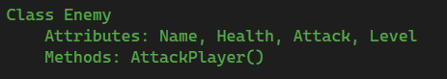
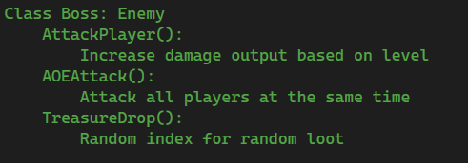
Enemy Classes
Enemy Class
Boss Child

Slide 10
Switching to Unity
Learning a new engine
Different forms of Object Orientated Programming
Game States
Animation
Level Loading
Monobehaviour

Slide 11

Testing & Debugging
11
Animations
Random Enemy Encounters
Group Enemy Encounters

Slide 12
The Main Challenges
12
Learning Unity
Unity Cloud Complications
Unity’s Backend Code vs Scripting
Prefabs
File Architecture

Slide 13
Improvements for the Future & What We’ve Learned
13
Collaborative Version Control
Better Asset Design
Game Design Doc

Slide 14

Thank you
14
Any questions before the demo?

